Slide 1
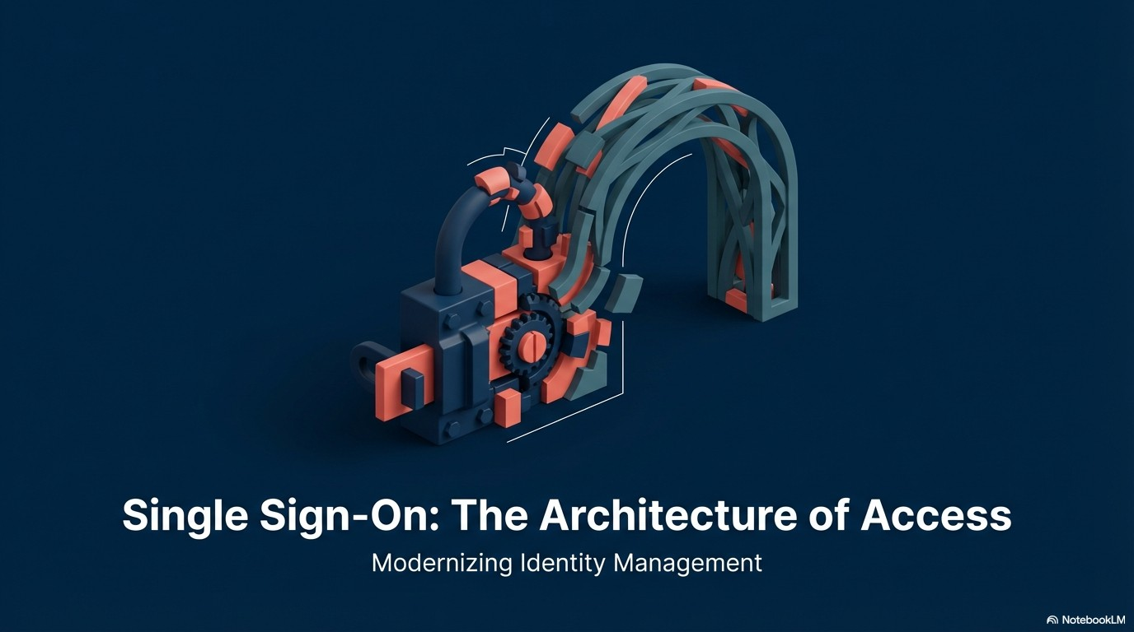
Authentication Challenges
Solution with SSO
Authentication Flow
Demo
Huỳnh Ngọc Sơn – hnson@tma.com.vn

Slide 2
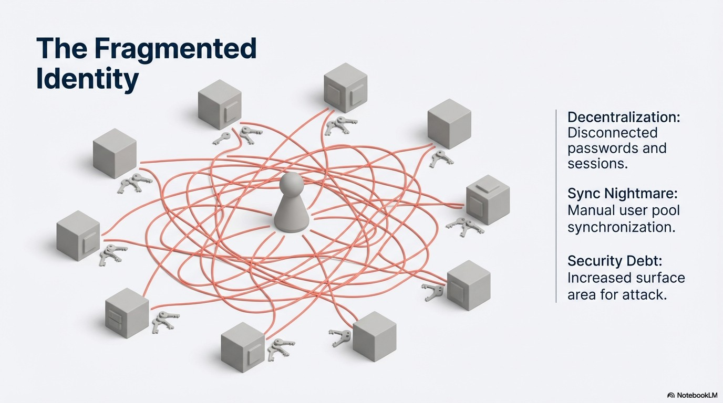
Notes:
Kkk app
So many password
Sync issue
Effort and cost to implement

Slide 3
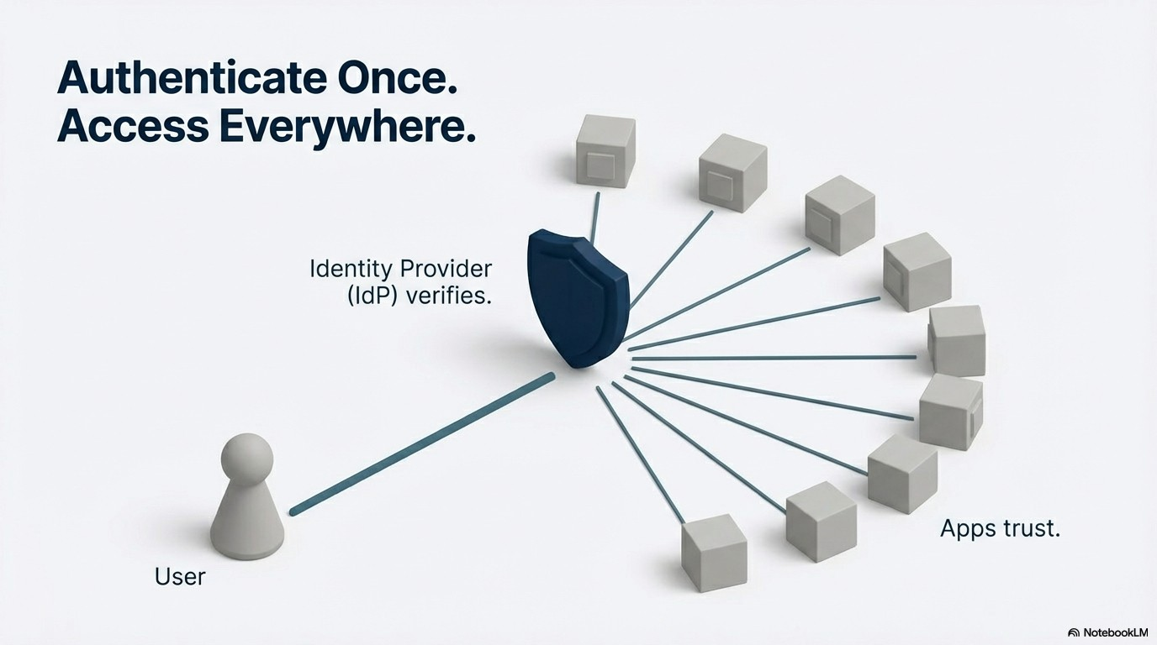

Slide 4
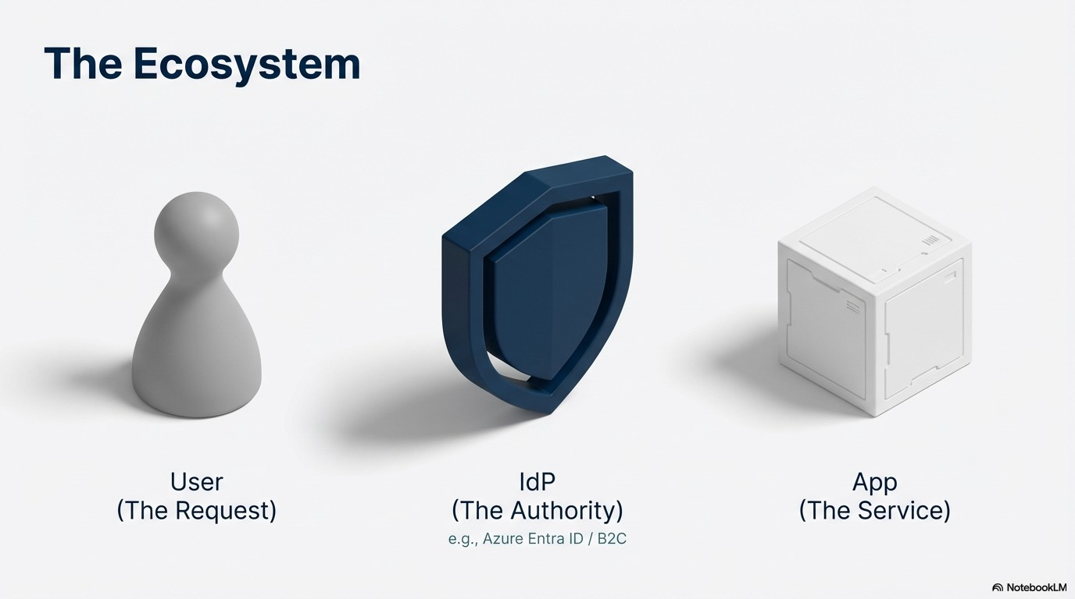

Slide 5
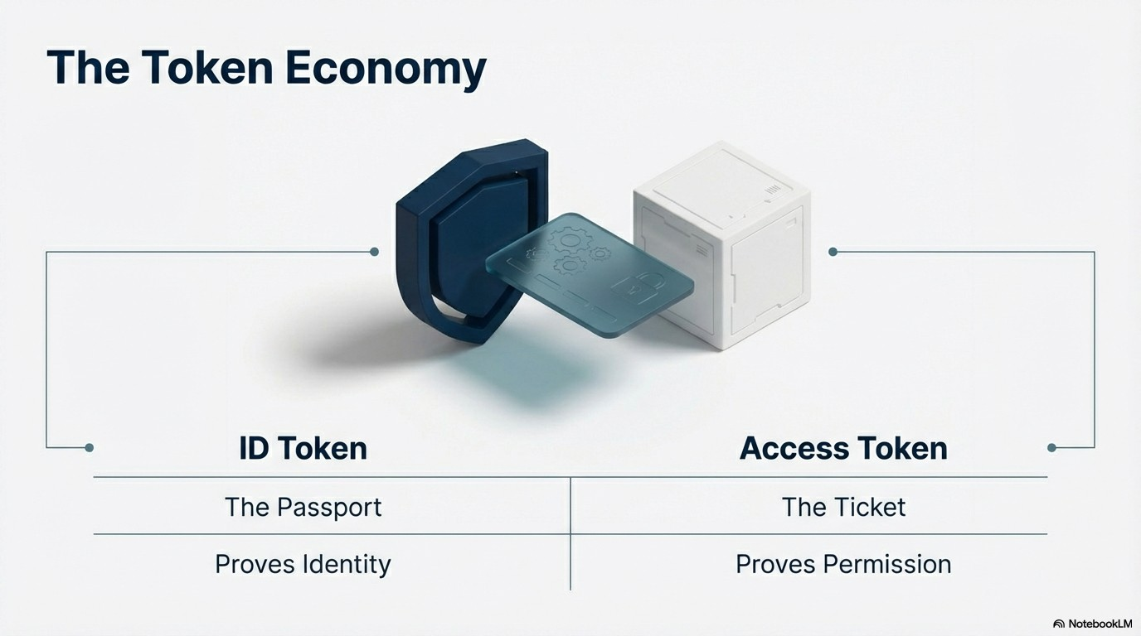

Slide 6
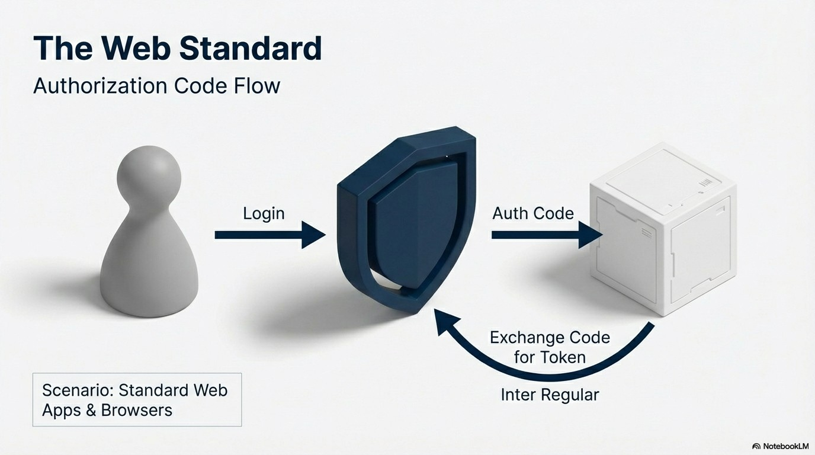

Slide 7
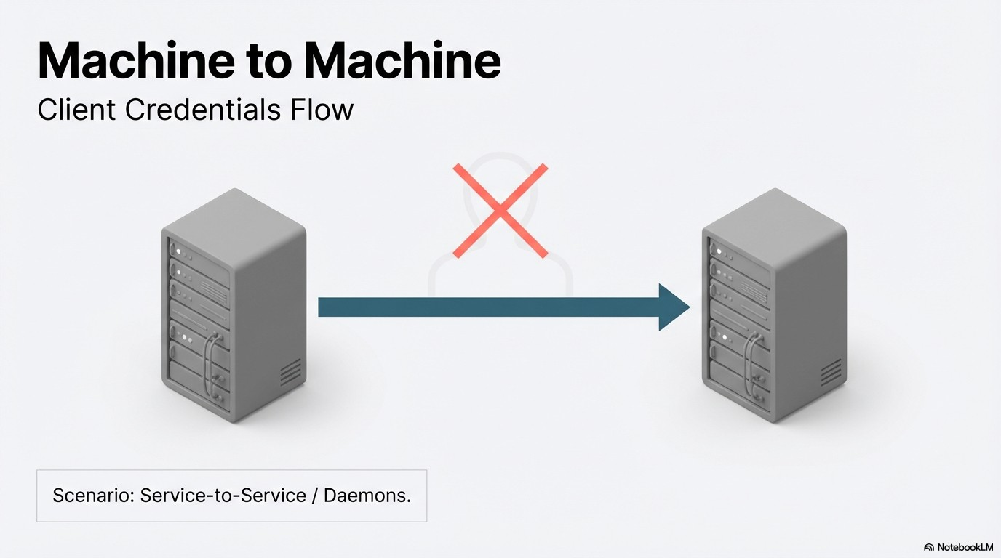

Slide 8
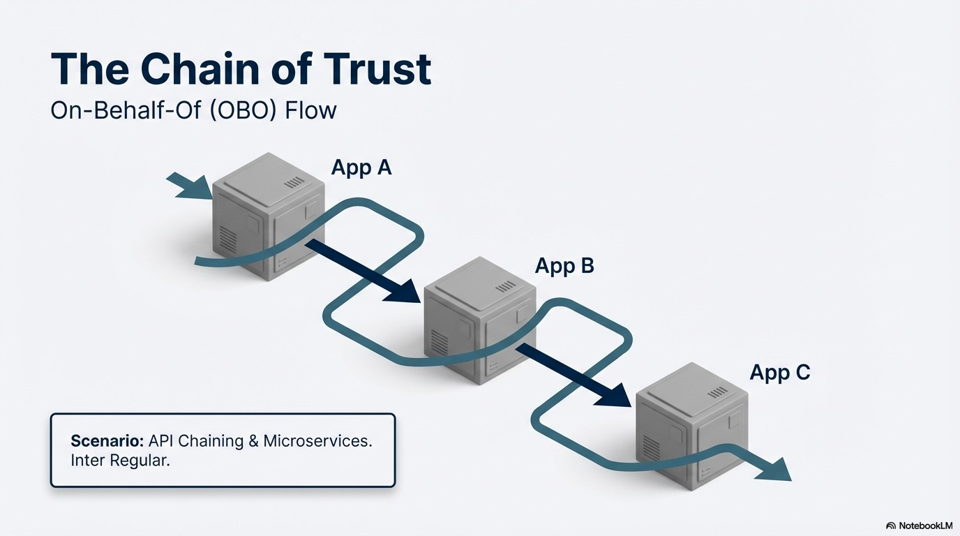

Slide 9
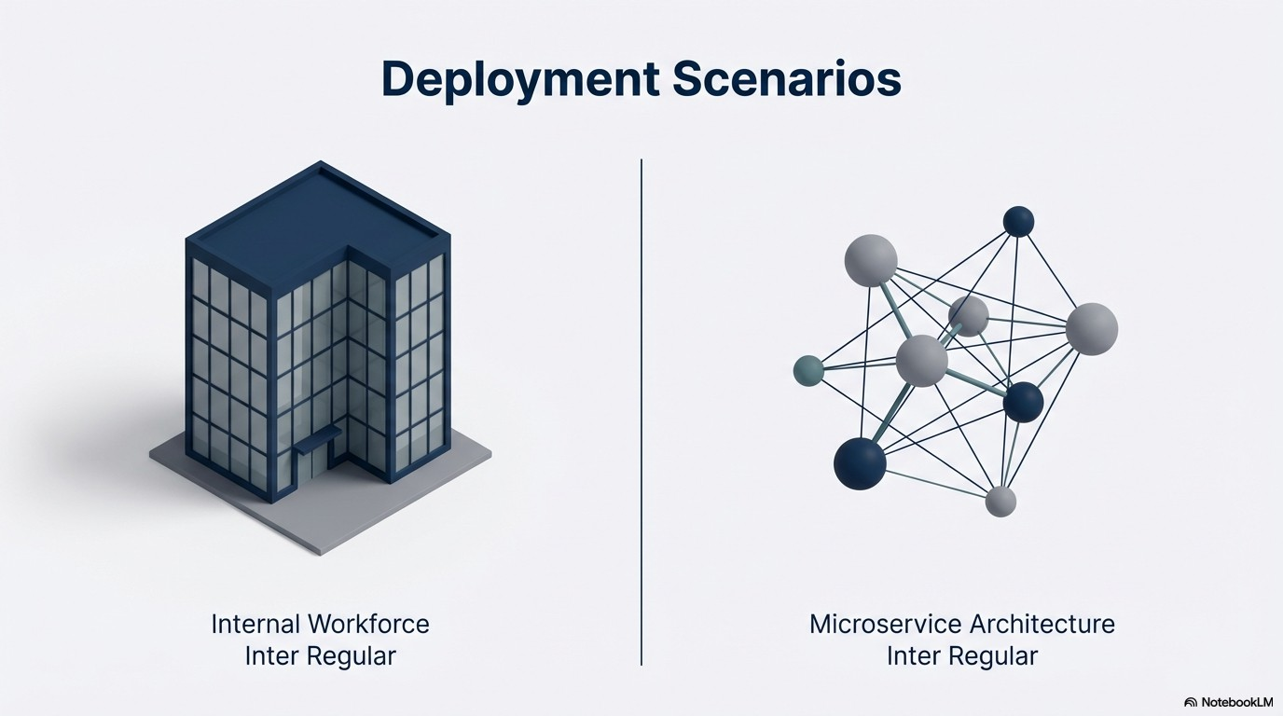
Notes:
Internal: Icon
microservice

